Slide 1
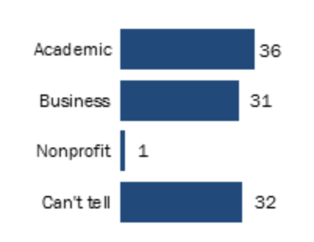
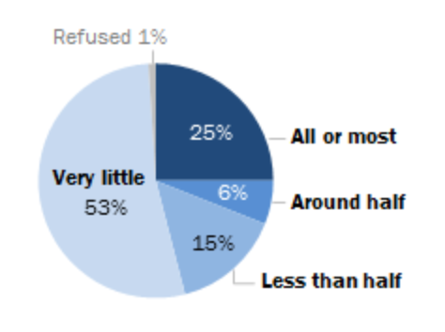

The Ethics and Utility of Amazon MTurk
Samuel Gibson sgibson@andrew.cmu.edu
Brandon Pek bpek@andrew.cmu.edu
What is MTurk?
Human Intelligence Tasks done for small rewards
Findings
Users of MTurk: Academics and Businesses dominate requests
Makeup of Mturk requesters (%):
Conclusion
MTurk is a powerful platform for requesters, turkers, society
It also empowers disabled and underserved populations.
Regulation like minimum wages should be introduced to MTurk to correct failings of Free Economy
Turkers could be split into those working less than 5 hours a day and those working more
Amazon should regularly conduct studies on the well-being and demographics of Turkers
Types of Tasks | %
Collecting info from pictures | 37 %
Transcription | 26 %
Content matching | 13 %
Surveys | 13 %
Collect info from web | 7%
Website testing | 1 %
Other | 2 %
Quality of Work: Turkers are more educated than general workforce
 | General Workforce | Turkers
High School Graduate/less | 35% | 12%
Some College | 29% | 36%
College Degree/More | 36% | 51%
Financial Empowerment: Many Turkers use Mturk as a source of extra income for their primary job
Disabled peoples: 12% of surveyed completed crowdwork
Turkers portion of income that comes from Mturk:
Why care about MTurk
Empower underserved populations with flexible working conditions
Strong contributions to general academia, ML
Promote protection of workers from exploitation
References
Hitlin, P., & Hitlin, P. (2017, February 06). Mechanical Turk: Research in the Crowdsourcing Age. Retrieved from https://www.pewinternet.org/2016/07/11/research-in-the-crowdsourcing-age-a-case-study/
Difallah, Filatova and Ipeirotis, (2018, February 05). Demographics and Dynamics of Mechanical Turk Workers, WSDM 2018.
Buhrmester, Kwang, & Gosling, (2011). Amazon’s Mechanical Turk: A new source of inexpensive, yet high-quality, data? Retrieved from Perspectives on Psychological Science, Vol 6, pages 3–5.
Zyskowski, Morris, Bigham, Gray & Kane, (2015, March 13). Accessible Crowdwork? Understanding the Value in and Challenge of Microtask Employment for People with Disabilities, CSCW 2015.
Failures of the Free Economy
Turkers who rely solely on MTurk tend to be younger, less educated
Free Economy’s Demand = Supply does not account for variable wages, lack of career progression
Deontological Roles of Employer
Requesters and Amazon’s duty to well-being of Turkers.
Why are minimum wage laws not applicable?
Half of Turkers make less than $5 an hour and over 90% make less than $8 an hour.
Objectives
Analyze benefits and losses of stakeholders with demographics data
Question Free Economy’s Perfect Competition
Discuss Deontological roles of employer and applicability of regulations like minimum wages

